Slide 1
Mawlana Bhashani Science and Technology University Department of Information and communication Technology Report Title : Development Of Hospital Management System Course Title : Software development Project – I course Code : ICT_1200
Presented by : Supervised by:
Nurjahan Akter Ziaur Rahman
ID : IT-23045 Assistant Professor
Dept. of ICT, MBSTU

Slide 2
Presentation Outline : 1. Introduction 2. Specification 3. Features 4. Source Code & Output 5. Live Demonstration 6. Conclusion 7. Q&A session

Slide 3
Overview:
1. Comprehensive Hospital management
2. Intuitive User Interface
3. Enhance Accessibility
4. Optimized C-Based Implementation
5. Secure Administrative Privileges

Slide 4
Objective :
1. Optimize Hospital Operations
2. Enhance User Experience
3. Simplify Admission and discharge
4. Maximize Efficiency with C Programming
5. Empower Hospital Administrations
6. Enhance Data Accuracy
7. enable Scalability

Slide 5
Technology Used :
1. C language
2. Data Structure
3. String Manipulation
4. User Input and Output Operations
5. Standard I/O Library
6. Consol Control
7. Memory management

Slide 6
Features :
1. Adding Patients
2. Discharging Patients
3. Administrative Privileges and Management
4. Patient List and Total Patient Count
5. Easy patient Management
6. Deleting Patient
7. Searching Functionality

Slide 7
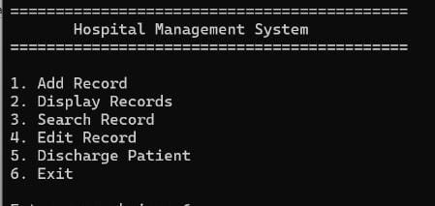
Main menu :
void mainMenu() {
int choice;
while (1) {
titleDisplay();
printf("\n1. Add Record");
printf("\n2. Display Records");
printf("\n3. Search Record");
printf("\n4. Edit Record");
printf("\n5. Discharge Patient");
printf("\n6. Exit");
printf("\n\nEnter your choice:”);

Slide 8
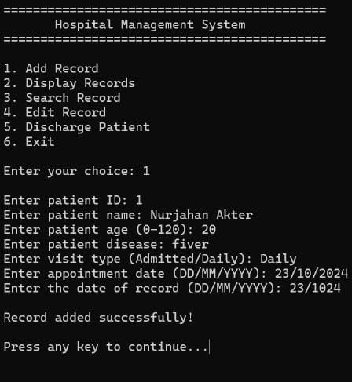
New patient entry :
// void addrecord function was used in this part .

Slide 9
/ /Add record function
void addRecord() {
if (patientCount >= MAX_PATIENTS) {
printf("\nCannot add more records. Maximum limit reached.\n");
pauseAndClear();
return;}
struct Patient p;
printf("\nEnter patient ID: ");
scanf("%d", &p.id);
if (findPatientById(p.id) != -1) {
printf("\nA patient with this ID already exists. Please use a unique ID.\n");
pauseAndClear();
return; }
printf("Enter patient name: ");
scanf(" %[^\n]%*c", p.name); // Allows spaces in name

Slide 10
do {
printf("Enter patient age (0-120): ");
scanf("%d", &p.age);
if (p.age < 0 || p.age > 120) {
printf("\nInvalid age! Please enter an age between 0 and 120.\n");
}
} while (p.age < 0 || p.age > 120);
printf("Enter patient disease: ");
scanf(" %[^\n]%*c", p.disease); // Allows spaces in disease name
printf("Enter visit type (Admitted/Daily): ");
scanf("%s", p.visitType);
if (strcmp(p.visitType, "Admitted") == 0) {
printf("Enter number of days for admission: ");
scanf("%d", &p.admissionDays);
} else {
printf("Enter appointment date (DD/MM/YYYY): ");
scanf("%s", p.appointmentDate);
p.admissionDays = 0; // No admission days for daily visit}
printf("Enter the date of record (DD/MM/YYYY): ");
scanf("%s", p.dateAdded);
patients[patientCount++] = p;
printf("\nRecord added successfully!\n");
pauseAndClear();
}

Slide 11
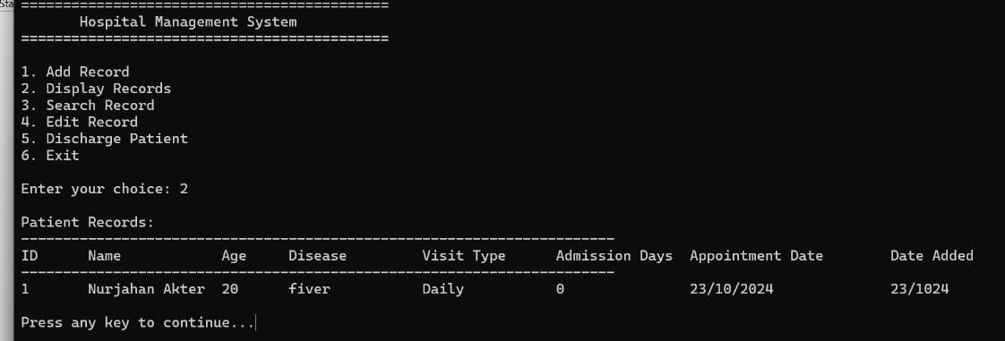
Patient list :
// Display records function
void displayRecords() {
if (patientCount == 0) {
printf("\nNo records found!\n");
} else { printf("\nPatient Records:\n");
printf("-----------------------------------------------------------------------\n");
printf("ID\tName\t\tAge\tDisease\t\tVisit Type\tAdmission Days\tAppointment Date\tDate Added\n");
printf("-----------------------------------------------------------------------\n");
for (int i = 0; i < patientCount; i++) {
printf("%d\t%-15s\t%d\t%-15s\t%-10s\t%d\t\t%s\t\t%s\n",
patients[i].id,
patients[i].name,
patients[i].age,
patients[i].disease,
patients[i].visitType,
patients[i].admissionDays,
patients[i].appointmentDate,
patients[i].dateAdded);}}
pauseAndClear(); }

Slide 12
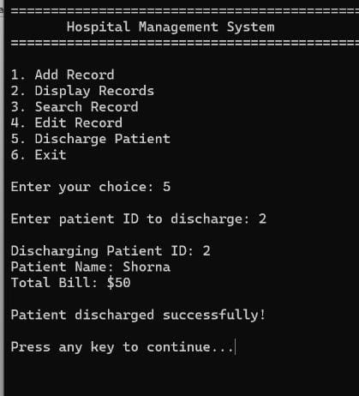
Discharging a patient
void dischargePatient() {
int id;
printf("\nEnter patient ID to discharge: ");
scanf("%d", &id);
int index = findPatientById(id);
if (index != -1) {
struct Patient p = patients[index];
printf("\nDischarging Patient ID: %d\n", p.id);
int bill = 0;
if (strcmp(p.visitType, "Admitted") == 0) {
bill = p.admissionDays * ADMISSION_FEE;
} else {
bill = DAILY_FEE }
printf("Patient Name: %s\n", p.name);
printf("Total Bill: $%d\n", bill);
for (int i = index; i < patientCount - 1; i++) {
patients[i] = patients[i + 1] }
patientCount--;
printf("\nPatient discharged successfully!\n");
} else { printf("\nPatient not found!\n"); }
pauseAndClear();}

Slide 13
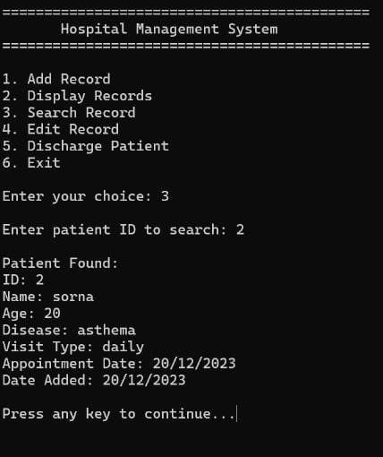
Searching a Record by Id
void searchRecord() {
int id;
printf("\nEnter patient ID to search: ");
scanf("%d", &id);
int index = findPatientById(id);
if (index != -1) {
printf("\nPatient Found:\n");
printf("ID: %d\n", patients[index].id);
printf("Name: %s\n", patients[index].name);
printf("Age: %d\n", patients[index].age);
printf("Disease: %s\n", patients[index].disease);
printf("Visit Type: %s\n", patients[index].visitType);
if (strcmp(patients[index].visitType, "Admitted") == 0) {
printf("Admission Days: %d\n", patients[index].admissionDays);
} else {
printf("Appointment Date: %s\n", patients[index].appointmentDate);
}
printf("Date Added: %s\n", patients[index].dateAdded);
} else {
printf("\nRecord not found!\n"); }
pauseAndClear();}

Slide 14
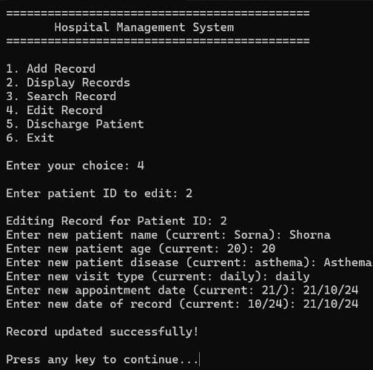
Editing record :

Slide 15
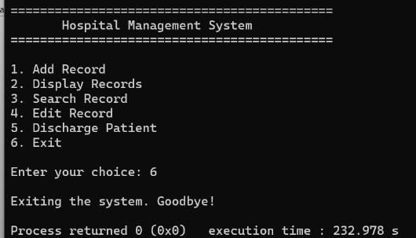
Exiting from system :

Slide 16
Live Demonstration

Slide 17
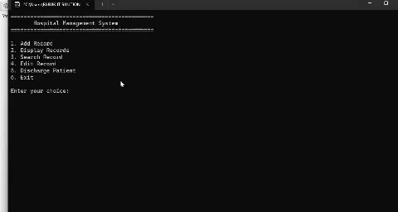

Slide 18
Q &A

Slide 19
Thank you

